Slide 1

HR ANALYTICS
EMPLOYEE RETENSION

Slide 2
PROJECT TITLE : HR Analytics ( Employee Retention )
MENTOR : Dipti Sinha
PROJECT MEMBERS :
Kanthi Sameera Pantula
Rohan Vinod Ankolekar
Bhagyashree Savalagimath
Omkar Ramdas Kavde
Nakka Rohitha

Slide 3
INTRODUCTION
HR analytics involves the collection and analysis of HR-related data, including employee data, performance metrics, and other relevant data points. By using advanced analytical tools and techniques, HR analytics provides valuable insights into HR processes and trends, enabling organizations to make more informed decisions about their employees and improve overall performance

Slide 4
PROBLEM STATEMENT
Average attrition rate for all Departments
Average hourly rate of Male Research Scientist
Attrition rate Vs Monthly Income stats
Average working years for each Department
Job role Vs Work life balance
Attrition rate Vs Years Since last promotion

Slide 5
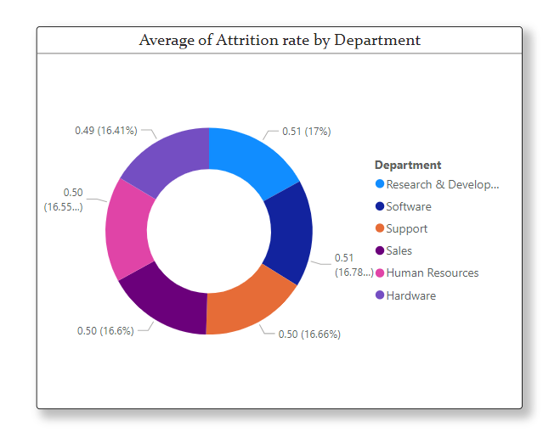
KPI 1 : Average attrition rate for all Departments.
This KPI is to find out the relationship between
Each department and its attrition rate and here attrition rate is highest for Research & Development Department whereas lowest is for Hardware
Department.
We can clearly say that attrition rate of
employees for every department is almost 50%
which indicates that attrition rate of employees does not depends on department. So, irrespective of the department almost 50% of employees are leaving the company.

Slide 6
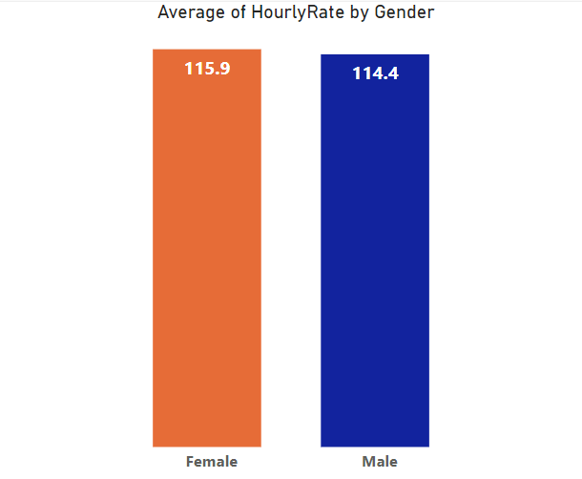
KPI 2 : Average hourly rate of Male Research Scientist
This KPI reveals average hourly rate of male research scientist, which is 114.4
The male research scientist receive a competitive average hourly pay comparable to the female research scientists. This pay is also consistent with industry standards across different departments.
The company is investing in talent no matter if it is male or female. The hourly rates for both male and female researches shows how serious is the company about having a diverse and skilled team.

Slide 7
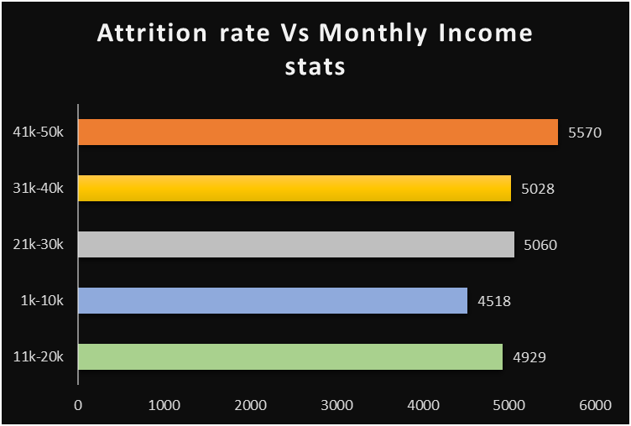
KPI 3 : Attrition rate Vs Monthly Income stats
This KPI shows the comparison of attrition rate and monthly income stats
This KPI shows that the highest attrition rate is in the 41K-50k Salary range, at 5570. This could be due no. of factors, such as employees feeling undervalued or being more likely to find better opportunities elsewhere at that salary level.
The overall attrition rate is 25105, which is 50.2% this is relatively high attrition rate, and it could be cause for concern.

Slide 8
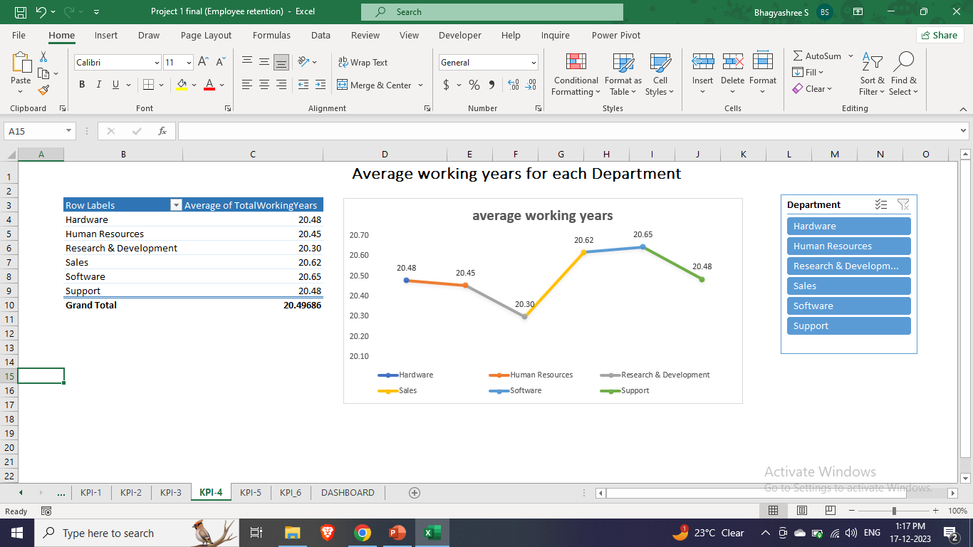
KPI 4 : Average working years for each Department
In this KPI we can find the average of working years of the Employee’s from each Department.
Taking Department into x-axis and Average working years into y-axis.
We can see that the lowest working years is for Research & Development Department, and the highers working hours is for Software Department.
We can easily find-out the result for this agenda with the help of KPI & graphical visualization.

Slide 9
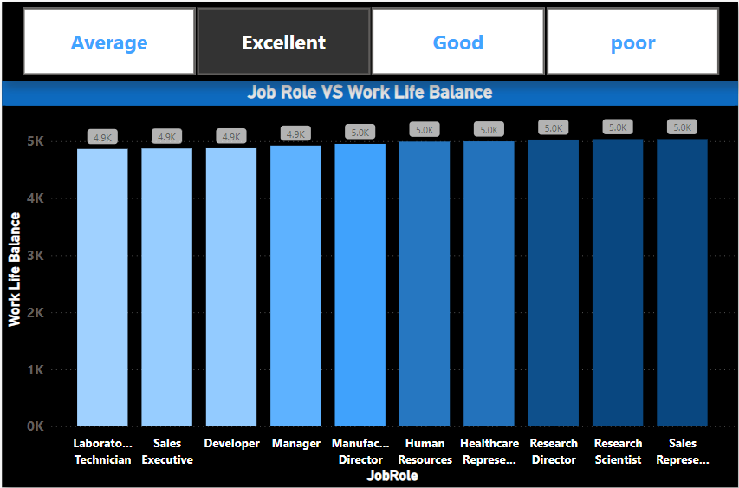
KPI 5 : JOB ROLE VS WORKLIFEBALANCE
In this KPI we can measure the work-life balance of employees based on their job roles and categories over different years.
Select clustered column chart, add job role into X-axis and work life balance into Y-axis. Add slicer to know status of work life balance.
By analyzing the jobrole VS work life balance We can clearly say that Sales Representative and Research Scientist tied for highest Sum of WorkLifeBalance at 5036, followed by Research Director. Laboratory Technician had the lowest Sum of WorkLifeBalance at 4864.Across all 10 JobRole, Sum of WorkLifeBalance ranged from 4864 to 5036.

Slide 10
KPI-6 ATTRITION RATE VS YEAR SINCE LAST PROMOTION RELATION
This KPI help to analyze the relationship between employee attrition helps organizations understand how the timing of promotions may impact employee retention.
It has been observed from the data that more employees falling within 1-10 years LPR i. e 20,718 employees out of 50000 and have avg . attrition rate of 50.24% employees from 11-20 years of LPR have 3,428 which is 49.84% and21-30 Years employees are 809 which is 50.96% and 30+ Employees are 105 .
By analyzing the Attrition Rate vs. Year Since Last Promotion, organizations can make informed decisions to improve employee satisfaction, enhance retention strategies, and optimize their talent management processes
Retention Analysis, Career Progression Satisfaction, Identifying Promotion Patterns, Employee Engagement need to be monitored.

Slide 11
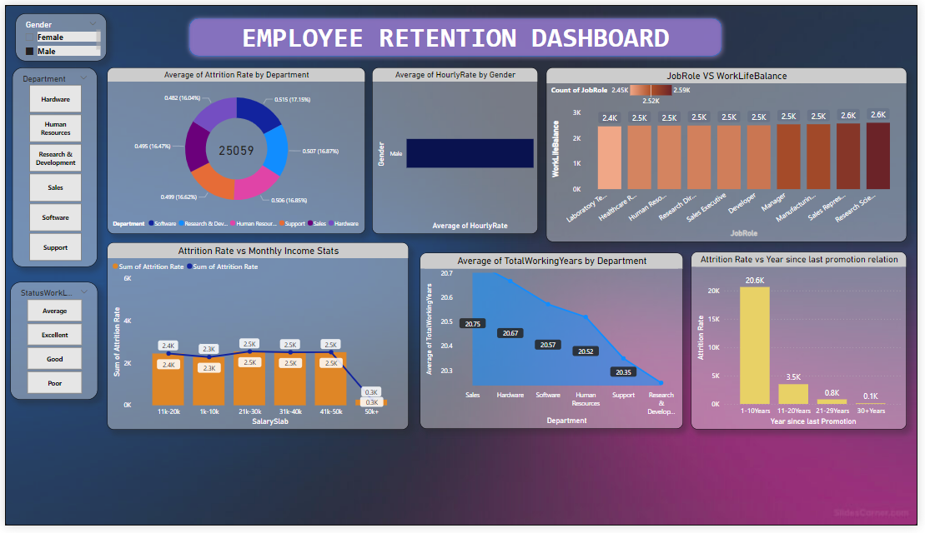
Dashboard

Slide 12
Conclusion
Different department have different staff turnover-Research & Development is high, while hardware is low. This helps the organisation to focus on specific areas for employee retention efforts.
Overall, about half of employees leave, no matter the department. This indicates the need for organization-wide strategies to enhance employee retention.
Male research scientist get a good hourly pay, similar to female and industry standards. It shows the organization's commitment to fair pay and building a diverse, skilled team.
Employees leaving the company often earn between 41k - 50K. The organization needs to address their concerns to lower the overall high turnover rate of 50.2%
Here are some strategies to help minimize attrition is to : Conduct exit interviews, Competitive compensation benefits, Career development opportunities, Rewards and recognition, work-life balance, Positive work Environment, Employee engagement, Leadership Development, Flexible benefits,Performance management, Regular Employee surveys, Communication and Transparency.

Slide 13


